Slide 2

13-
14
Lesson 13-14
Remainder

Slide 3
Part 1
Division with Remainder

Slide 4
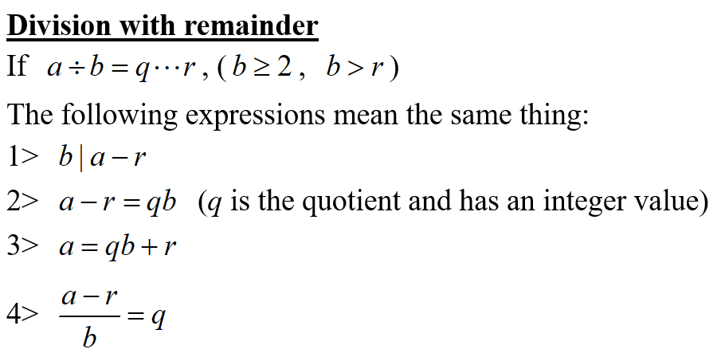
Lead in

Slide 5
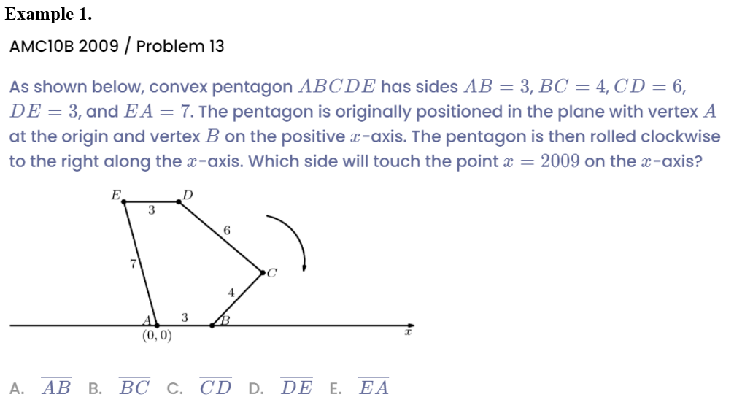
Example

Slide 6
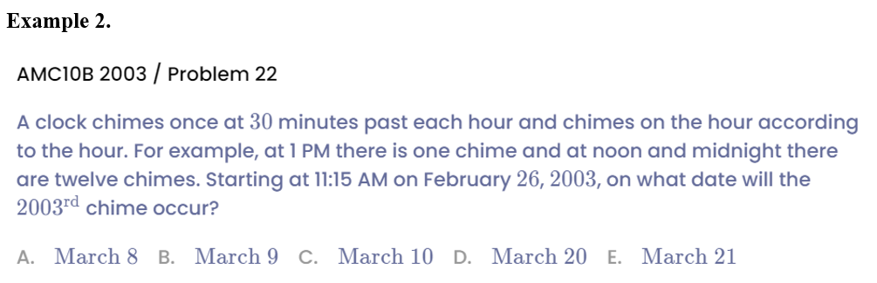
Example

Slide 7
Part 2
Property of Remainder

Slide 8
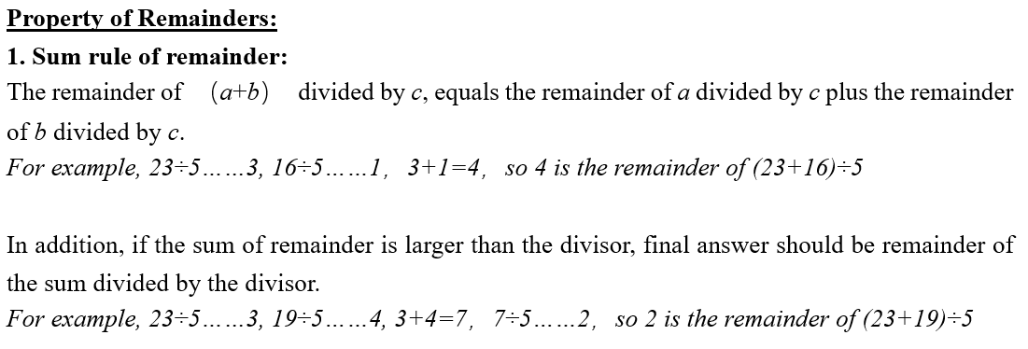
Lead in

Slide 9
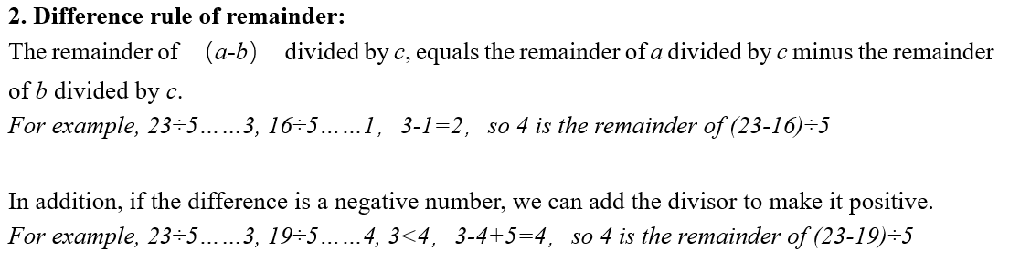
Lead in

Slide 10
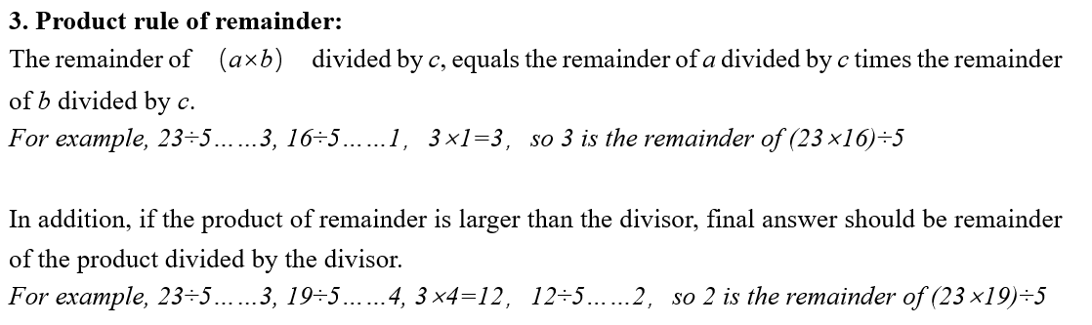
Lead in

Slide 11
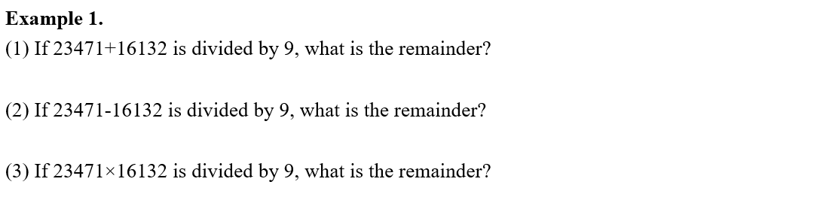
Example

Slide 12
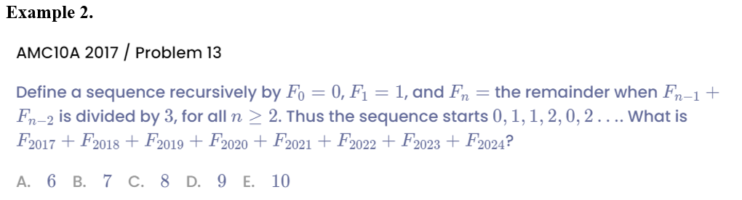
Example

Slide 13
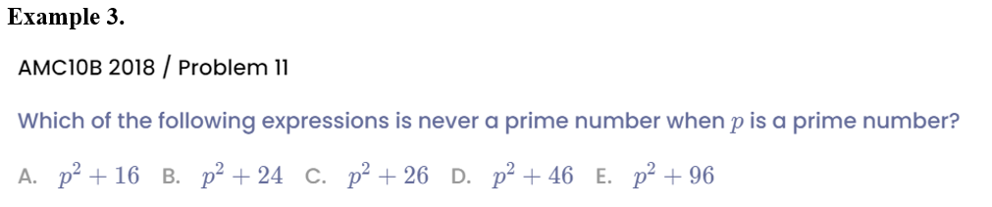
Example

Slide 14
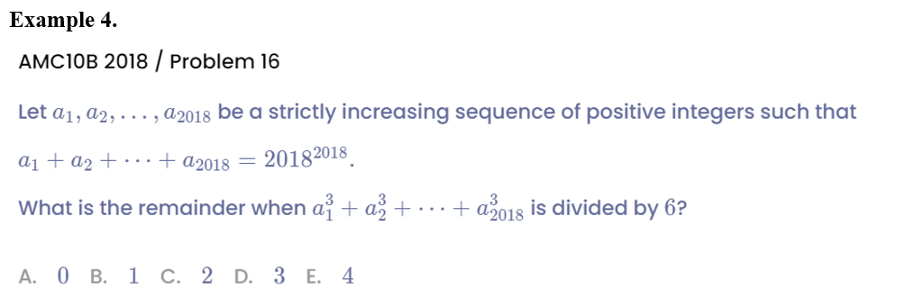
Example

Slide 15
Part 3
Last-n digit

Slide 16
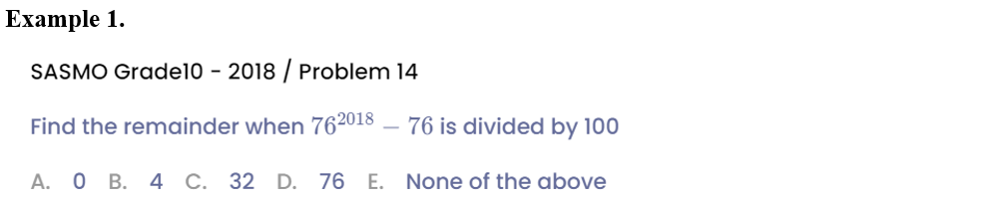
Example

Slide 17
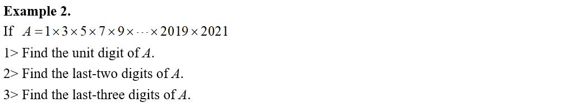
Example

Slide 18
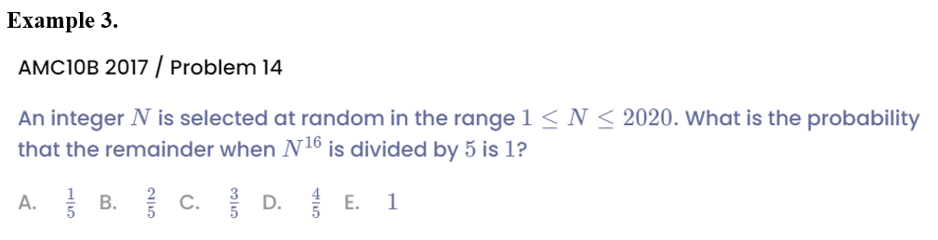
Example

Slide 19
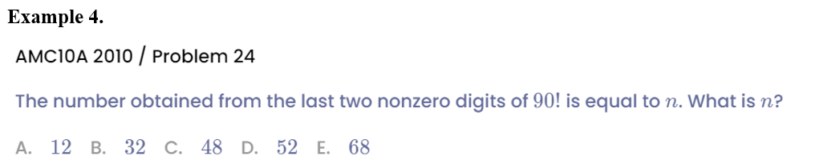
Example

Slide 20
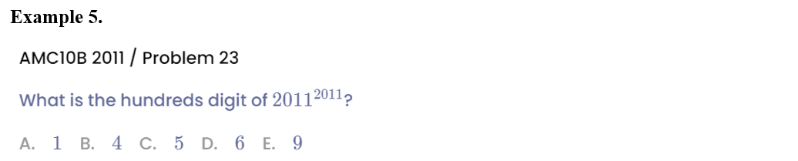
Example

Slide 21
Part 4
Chinese Remainder Theorem

Slide 22
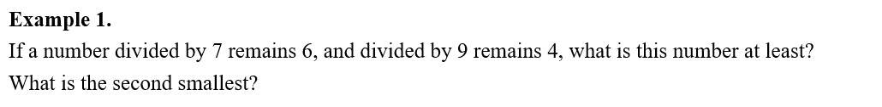
Example

Slide 23
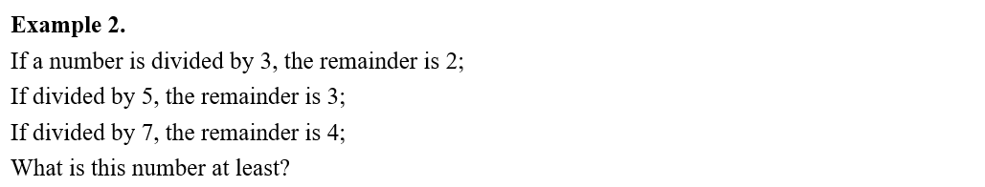
Example

Slide 24
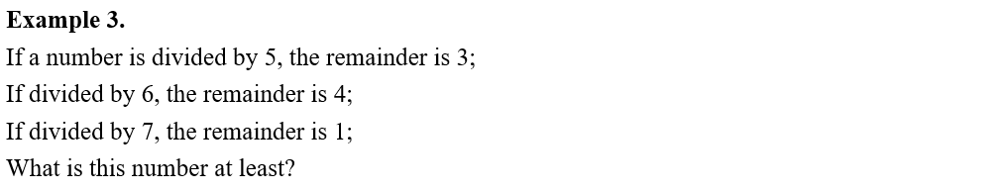
Example

Slide 25
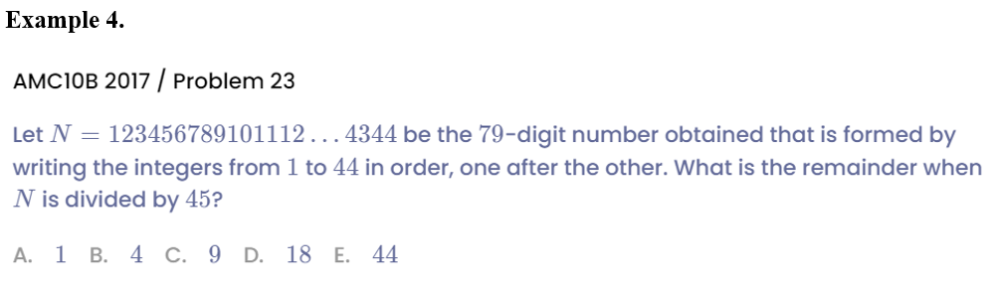
Example

Slide 26
Part 5
Challenge

Slide 27
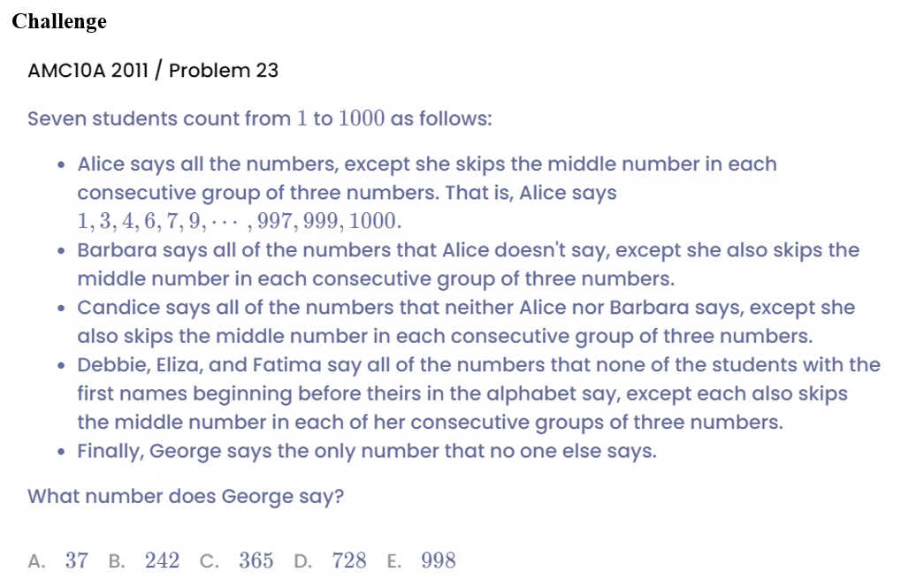
Example

Slide 28
See You Next Time!

